Slide 1

Sex-ACT; using acceptance and commitment therapy to help clients manage sexual concerns, problems, and worries
Dr Rich Blonna
William Paterson University
drrich@drrichblonna.com
www.sex-acttraining.com

Slide 2
ACT principles and practices can be applied to clients and students who do not have DSM IV sexual disorders
The “worried well” have sexual problems concerns and worries that can be managed with ACT principles and practices

Slide 3

SEX: The most powerful erogenous zone is between the ears in one’s mind, not between the legs in one’s genitalia.

Slide 4
Sexual response begins and ends in the brain with the mind playing a key role in desire, arousal, orgasm, and satisfaction.
Most people do not know how to unleash the power of their sexual minds.

Slide 5

ACT: can help people unleash the power of their sexual minds by understanding and accepting how the mind processes sexual information.

Slide 6
THE SEXUAL MIND: The mind is a 24/7 thinking and feeling machine capable of cranking out an endless stream of sexual thoughts, personal scripts, mental images, and emotions.

Slide 7
As a values-neutral form of therapy ACT does not qualify sexual thoughts, personal scripts, mental images, and feelings as good, bad, right, or wrong.
Sexual thoughts, personal scripts, mental images, feelings are either helpful or unhelpful in helping clients meet their values-congruent sexual goals.

Slide 8
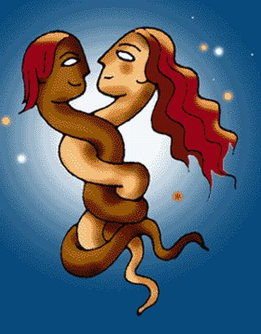
SEXUAL THINKING: Some of what the mind tells clients about their sexuality is very helpful in meeting their values-congruent sexual goals.
.

Slide 9

SEXUAL THINKING: and some of what it tells them is not very helpful and can contribute to getting stuck in a sexual rut.
Remember: they are not dysfunctional, just stuck.

Slide 10
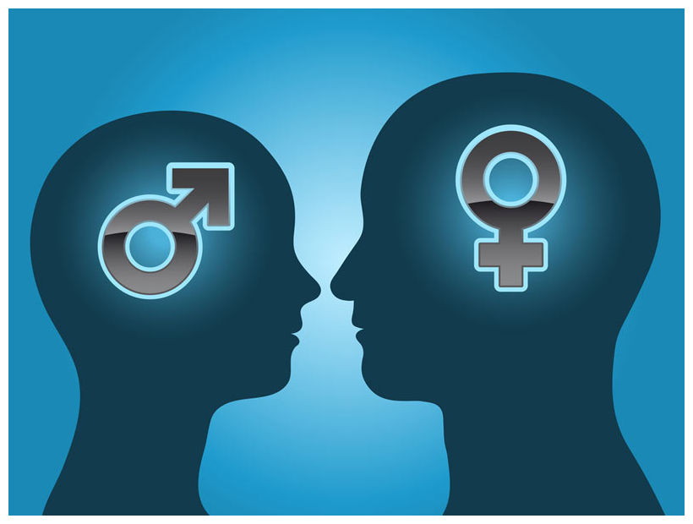
Helpful thoughts, personal scripts, mental images and emotions: support one's sexual values and values-congruent goals

Slide 11
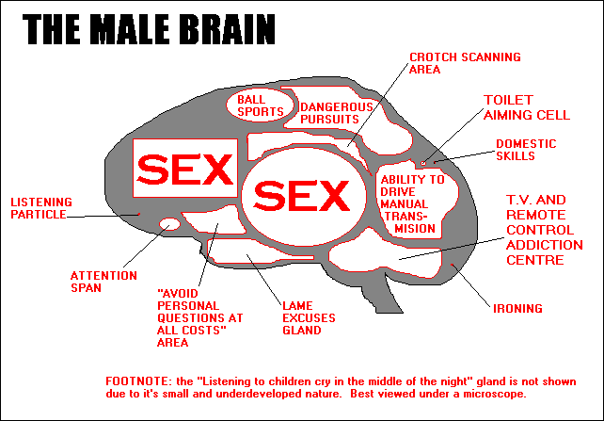
Sexual Identity: Most sexual thoughts and feelings revolve around some aspect of one’s sexual identity as a male or female.

Slide 12

Sexual Identity: there are four dimensions of sexual identity:
(1) biological sex
(2) gender identity
(3) gender role
(4) sexual orientation

Slide 13
Over the course of a lifetime, the mind creates a storehouse of personal scripts, mental images, and emotions related to each of the dimensions of one’s sexual identity

Slide 14

Biological Sex: One's sexual anatomy and physiology influence his/her sexual identity throughout one's life.
Ex: Females’ ability to conceive, carry a pregnancy to term, give birth, and breast feed an infant makes them very different from biological males

Slide 15
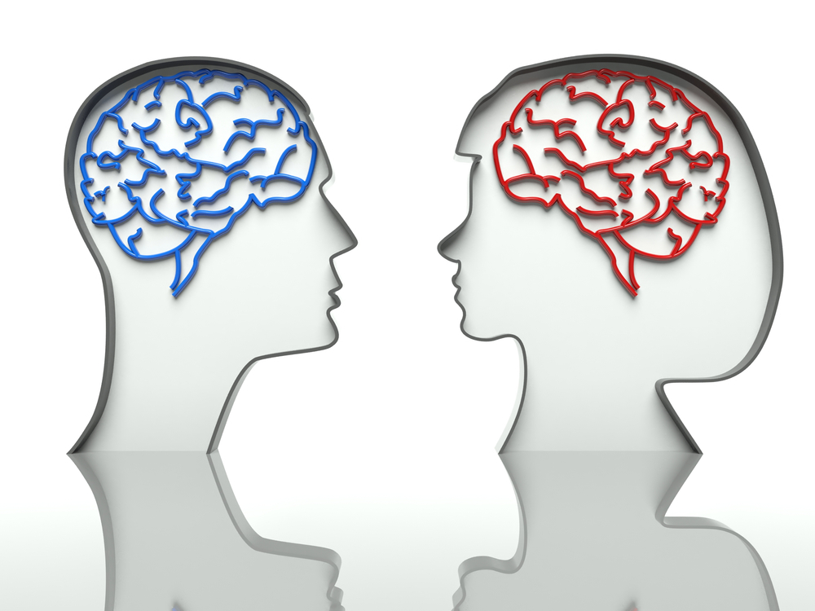
Gender Identity:
gender identity is one’s internal picture of what it means to be a man or woman (or neither).
.

Slide 16
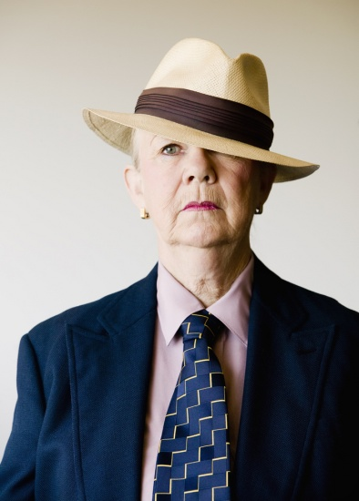
Gender Role:
Gender role is one's external portrayal of his/her gender identity.

Slide 17

SEXUAL ORIENTATION: sexual orientation is one’s adult, free choice of sexual partners (both the object of desire and actual sex partners).
Photo: Gandolfo Cannatella / Shutterstock.com

Slide 18

Getting Stuck: Clients get stuck sexually when they fuse with outdated and unhelpful sexual thoughts personal scripts, mental images, and emotions related to their sexual identities.

Slide 19

Getting Unstuck: breaking through barriers starts with helping clients identify their sexual values and set values-congruent goals to give their lives direction.

Slide 20

Getting Unstuck: Continues with mindfulness training.
Becoming more mindful of both internal and external factors.

Slide 21

Getting Unstuck: Involves taking committed action, not just thinking about their goals.
It involves teaching them that they can’t figure everything out in their heads.

Slide 22

Getting Unstuck: Continues with acceptance and willingness training, learning how to co-exist with unhelpful thoughts and lack of control while taking values-congruent action.

Slide 23

Getting Unstuck: Involves defusing from unhelpful, outdated sexual thoughts, personal scripts, mental images and emotions.
Realizing that although they are ever-present they do not have to control clients’ present and future actions.

Slide 24

In Closing: sexuality is a powerful life force that clients can unleash whenever they choose, despite the unhelpful sexual baggage they carry around. They can drop the bags and move forward committing to the sexual life they want and deserve or they can let the bags weigh them down and keep them stuck.

